Slide 1

MSP100 Career Learning: Managing your Career
Topic 1
Introduction to the unit

Slide 2
Today’s workshop
Introduction to the unit
Class activity: Graffiti
Write, pair, share: What is ‘career’ to you?
LMS: Finding your way around the unit site
Two mini lectures
How to pass the unit
Assessments, extension rules
Group activity: Desert island
Workshop expectations

Slide 3
MSP100
About me…
12 workshops – 2 hours each
Mini lectures – approximately 30 mins each (Dr Robert Payne) all lectures are recorded and available in LMS. We will watch them in class.
LMS
Weekly topics, readings, materials
Assessments (submission boxes under weekly topics, assessment guides, etc.)
My Unit Readings /readings under each topic
Unit Outline – please read and download!

Slide 4

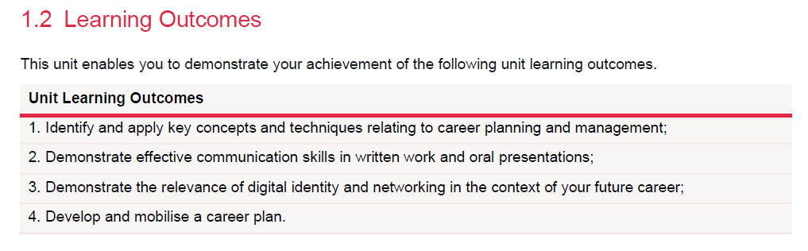
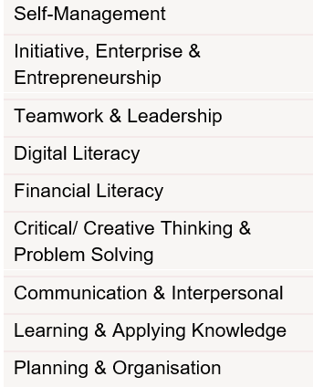
MSP100 Unit Learning Outcomes
PURPOSE:
This unit assists students to clarify their career aspirations and goals and supports them in planning the development of skills they will need for future career success.

Slide 5
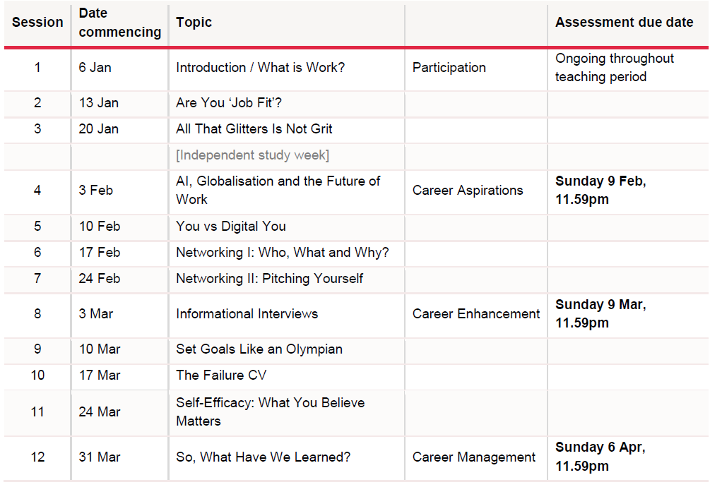

Slide 6

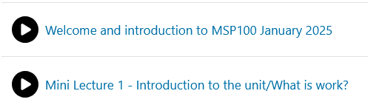
Two short welcome videos

Slide 7
To pass the unit:
At least 50% of total marks
Submit ALL assessments
Attend and contribute to at least 10 workshops – I will take attendance in the workshop each week
If you’re unwell, contact me before the workshop. Please get a medical certificate
Use of AI is strictly forbidden in the unit

Slide 8
How to do well in this unit…
Show up to the workshops
Prepare for workshops
Essential reading, reflection; make notes while you are reading
Videos, other media, recommended readings under weekly topics
Ask questions!
Complete assessments by the deadline
Extensions – ask early, always before the due date
Let me know how you’re going; get in touch if you are struggling. I am here to help!

Slide 9
I guarantee to you…
Email – reply within 48 hours on weekdays (some weekends I will be offline; reply Monday morning)
Marking turnaround of 15 working days (working days exclude weekends and public holidays)
Face-to-face meetings
Support when you need it

Slide 10
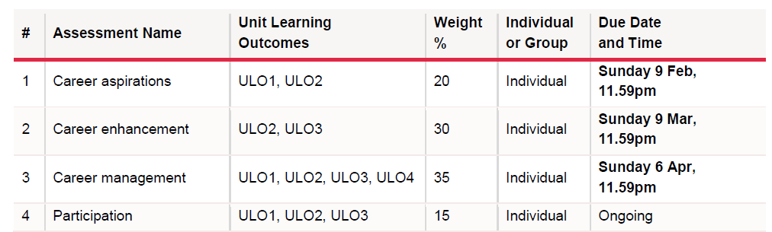
Assessments
Participation = 15% - Attendance, preparedness, participation and contribution in group work and class discussions. Must attend at least 10 workshops.
Assessment descriptions - LMS and Unit Outline

Slide 11
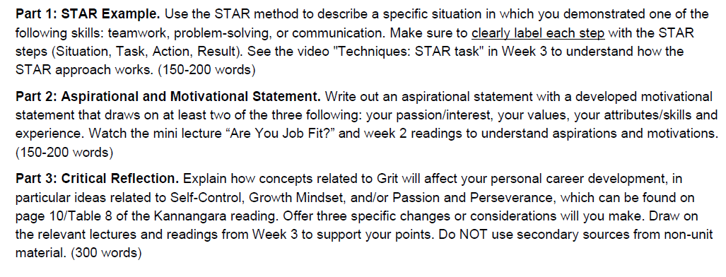
Assessment 1

Slide 12
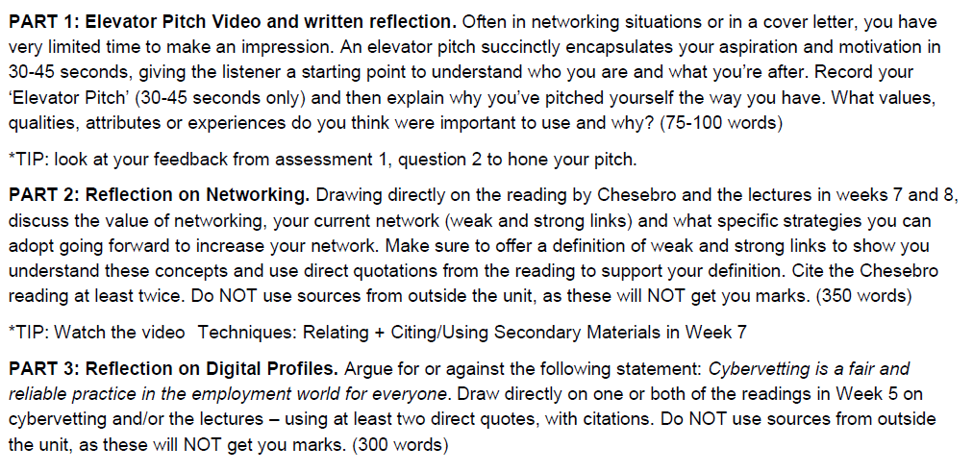
Assessment 2

Slide 13
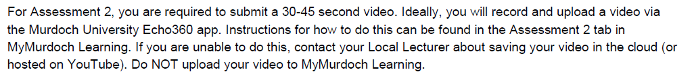

Assessment 2 – Video pitch
“Instructions” – a PDF link in LMS under the assessment box in Week 7.

Slide 14
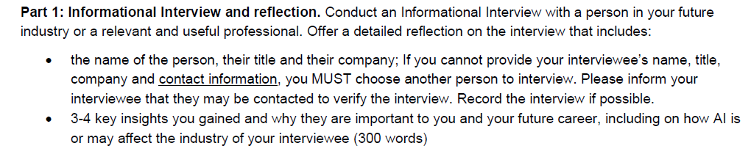
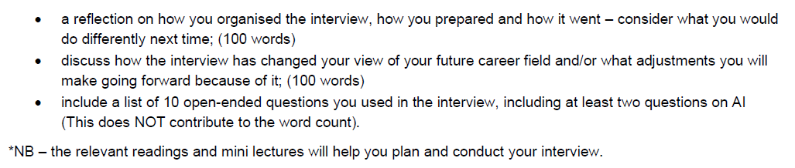
Assessment 3: Part 1

Slide 15
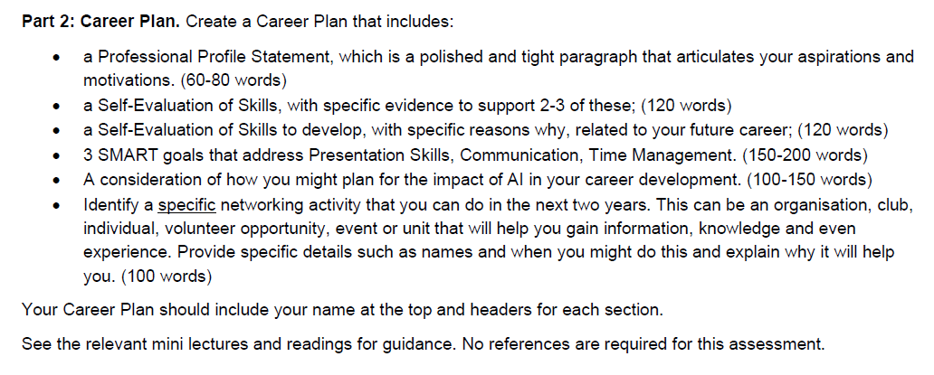
Assessment 3: Part 2

Slide 16
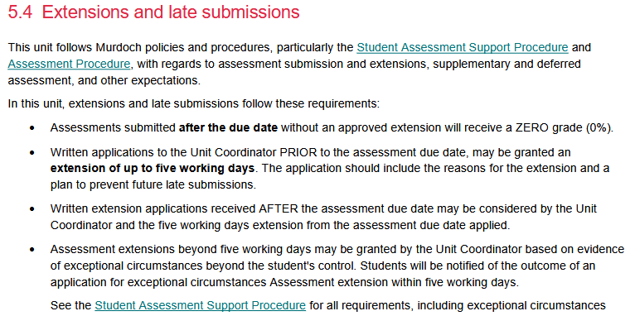

Slide 17

Extensions (up to 5 days from due date)
Must apply prior to due date for extensions of up to five working days in writing to Unit Coordinator
Must include reason and a plan to prevent future late submissions
Applications for extension may be accepted after the due date (Unit Coordinator’s decision)
Irrespective of when approved, assessments must be submitted within 5 days of due date unless exceptional circumstances apply

Slide 18
Extension beyond five days (Exceptional)
Evidence of exceptional circumstances beyond student control
Documentation will:
Be related to reasons provided
Include dates of affect of relevant circumstances
Support the extension period requested
Be submitted in English.
Student is responsible to complete by revised due date
Unit Coordinator notifies the outcome to student within 5 working days of request

Slide 19
Group activity: Introductions
Introduce yourself
If you had to take 5 things to a desert island, what would they be?
Hear from everyone in your group
Group: Choose your favourite answers

Slide 20
Group activity: Share with the class
Each group: Share with the class your group’s favourite answers (you can keep them anonymous if you like)
Class: What might these things indicate about the person’s interests? Values? Talents?
How might this be linked to the unit aims?

Slide 21

Graffiti
Go around the class and scribble your answers on the whiteboards:
I learn in workshop best when ….
I don’t like it when…
I don’t understand/am nervous about xx in
(this unit, this university, this trimester…)
I’m excited for…

Slide 22
Our workshop pact

Slide 23
LMS
Let’s have a look at LMS / MyMurdoch Learning…
Unit Outline
My Unit Readings
Electronic submission of assessments - where to find the assessments
(you may find it helpful to make a note of when they are due, and where to find them)

Slide 24
Write, pair share Jot down your answers (individuals):
What does the term ‘career’ mean:
- To me?
- In a globalizing world?
- In my local context (country/city/community)?
- In my life?

Slide 25
Write, pair, share Jot down your answers:
Share your answers with the person sitting next to you
Pairs: Share with the class
Class discussion:
- What are your thoughts, going into the unit?
- What do you hope to achieve?
- How do you feel about the future in terms of career?

Slide 26

Preparation for next workshop…
Do the readings as listed in LMS
If you have not yet done so, read the Unit Outline
Spend some time looking around the unit’s LMS site, get familiar with how it works – write down any questions you have to bring to class next week

